Slide 1

MS Generated Modules
-Sanskar Dwivedi, Software Developer, SmartOps CALA

Slide 2

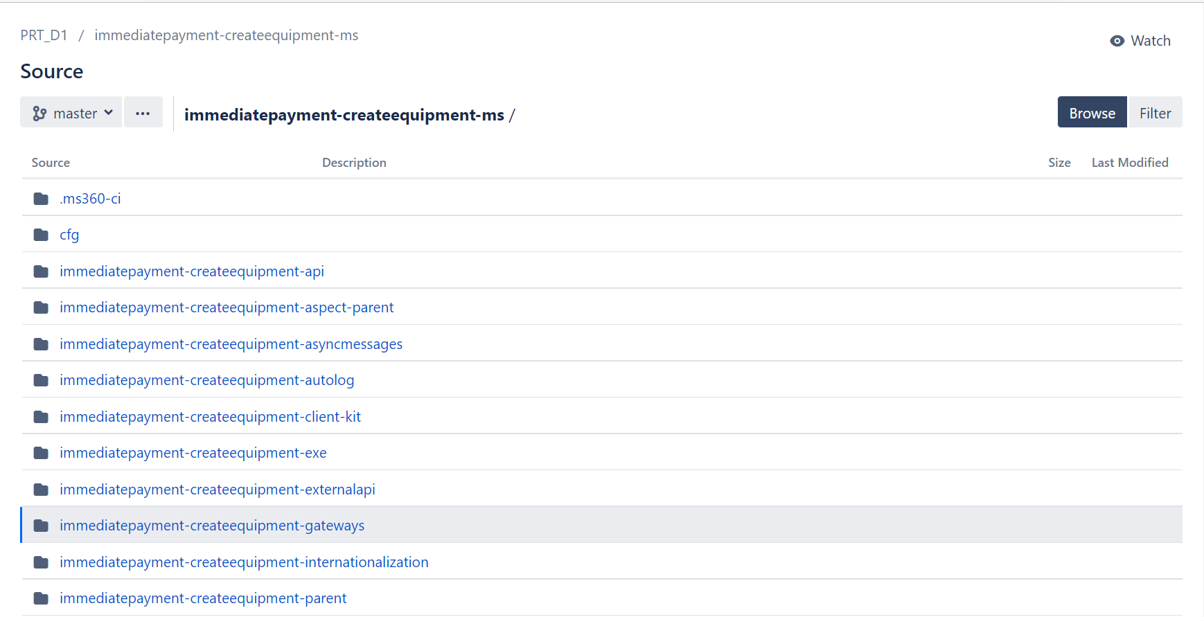
When we are generating MS from MS-Builder, it is generating a Maven Multi-Module architecture as follow:

Slide 3
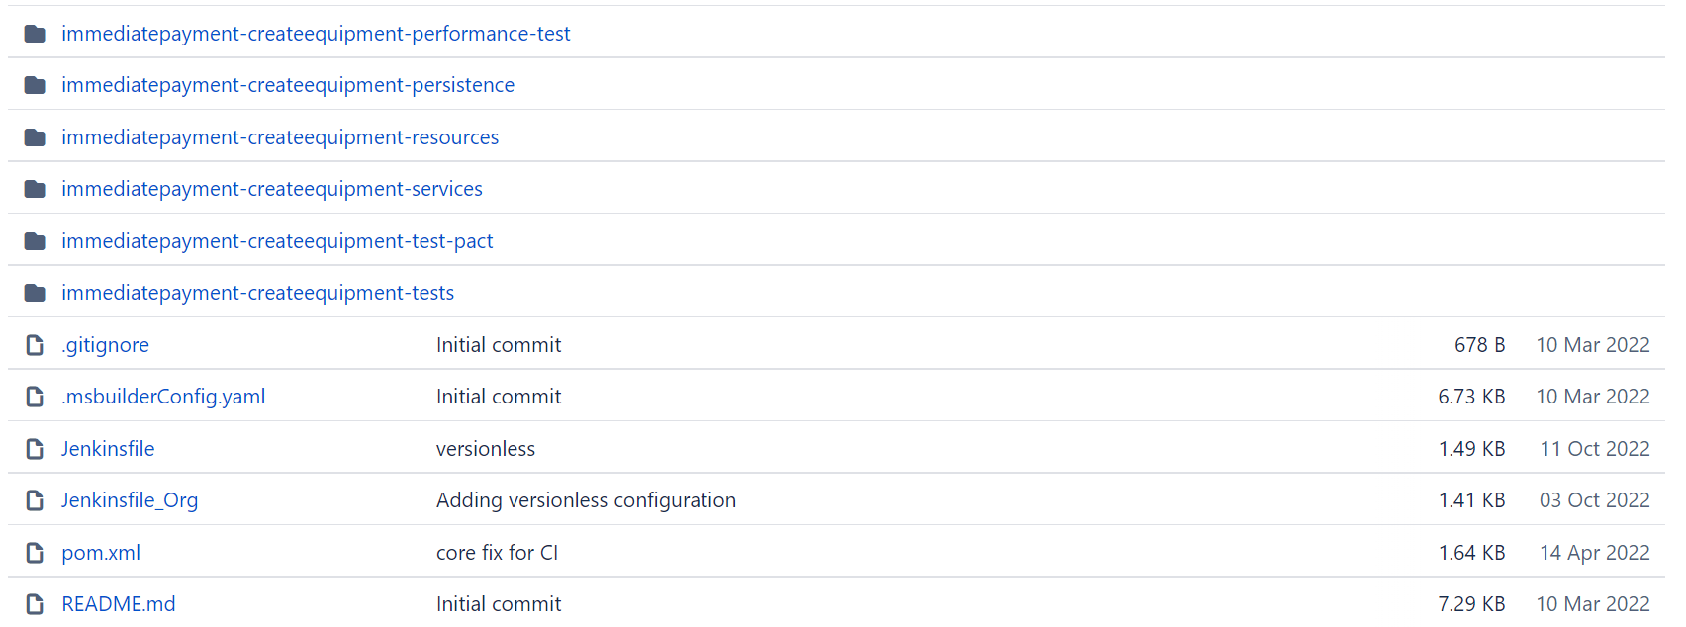

Slide 4
API Module
This module contains the YAML file with the Swagger definition for the given application.
It also generate the server-side code, java code for external API's & HTML documentation for the services defined in the YAML file.
API Module contains the Request Mappings, Request & Response Model Classes, Management YAML and Delegate Interfaces When we run Maven Build on the API module, then all the Model Classes, interfaces and implementations are generated in target folder generated sources after reading the Swagger YAML file which internally uses Swagger Code-gen.

Slide 5
Aspect Parent Module
Aspect Parent Module contains the dependency of Auto logging, Idempotency, privacy logging etc.., so that when other modules are inheriting from Aspect-Parent Module, they get the overridden aspect concerns.
For example: If we have any module inheriting from Aspect-Parent module, it automatically has the abilities of auto logging, idempotency, etc..
Pom.xml of aspect-parent: <dependency>
<groupId>com.amdocs.digital.ms.billing.paymentmanagementhook</groupId>
<artifactId>billing-paymentmanagementhook-autolog</artifactId>
</dependency>
<dependency>
<groupId>com.amdocs.msbase</groupId>
<artifactId>msb-idempotency</artifactId>
</dependency>
<dependency>
<groupId>com.amdocs.msbase</groupId>
<artifactId>msb-privacy-logging</artifactId>
</dependency>

Slide 6
Async Messages Module
Used for async messaging.
This module has 1 YAML & using swagger codegen, it generates the entity module.

Slide 7
Autolog Module
Used for logging purposes.

Slide 8
Client-Kit Module
- This module contains only the POM file to generate the client kit using the YAML file in xxxxxxxxxx-api module. - This module is not used by consumers of the service (which copy the API) but may be used when testing the service.

Slide 9
EXE Module
Contains the executable jar of the MS and the docker image & other prerequisites for running/deploying MS.
Also, while running the application in local, we will select this module and then start the application.
All other layers are part of Java code, only EXE layer is part of deployment configuration.

Slide 10
Gateways Module
Used for both sync and async messaging through feign client.
This module is used when we are calling any other microservice from our MS.
This module accesses external services that are used by our MS. In addition to service consumption, it includes asynchronous message publishing & subscription.

Slide 11
Internationalization Module
- Used when we are displaying any message specific to any Locale. - This module picks up the message key (which remains the same), but the values of those keys will change as per the locale (as per the countries and their language).

Slide 12
Parent Module
- Contains the Maven Parent POM. - This POM is the common parent of all the maven components in MSB libraries. - This POM has all the version information for all the dependencies & maven plugins used in rest of the MSB libraries. - All dependencies required by MSB libraries are managed in this POM. The other MSB libraries should have to add the dependencies without the version information. - The versions of all the dependencies are exposed as properties, so if inheriting project needs to use a different version, they can override the property to do so.

Slide 13
Performance Tests Module
Used for writing performance test cases for our application, usually done after the application is stable & in production. To learn more: Performance Testing - javatpoint

Slide 14
Persistence Module
Whenever we are integrating Couchbase in our application & we are writing the code for Couchbase to persist any data, we need to write the code in this module, i.e. For implementing any operations related to Couchbase DB, we use this module.
In short, this module contains all Couchbase related API’s.

Slide 15
Resources Module
- Contains the implementation of the delegate interfaces generated by the Swagger Code Generator. - Also contains the mapper interface & implementation to map the resource layer models to and from the service layer models. - Why need mappers? We have parameters coming in from resource layer that needs to be converted to DTO before sending to service layer & we have DTOs from service layers which needs to be converted to parameters before sending as response to resources layer.

Slide 16
Services Module
- Most important module – Contains the basic business logic or service/domain implementation. - Contains the DTO interfaces under the .repository.dto package. - Implementation for these interfaces can be found in the persistence layer. - The mappers in the resources layer use these interfaces to map resource models to service models.

Slide 17
Test-Pact Module
- Used for PACT(Contract) testing. - Contract testing is a technique for testing an integration point by checking each application in isolation to ensure the messages it sends & receives conforms to a shared understanding that is documented in a contract. - Pact is a code-first tool for testing HTTP and message integrations using contract tests.

Slide 18
Test Module
Used for writing “JUNIT” test cases for our application.

Slide 19


Thank You
- Sanskar Dwivedi Software Developer SmartOps-CALA (sanskard@amdocs.com)

